Slide 1
BLOXORZ
B07901020 劉昀昇

Slide 2
CONTENT
Brief introduction
Problem formulation
Bloxorz graph
CNF encoding
Definition
Rules
Experiment

Slide 3
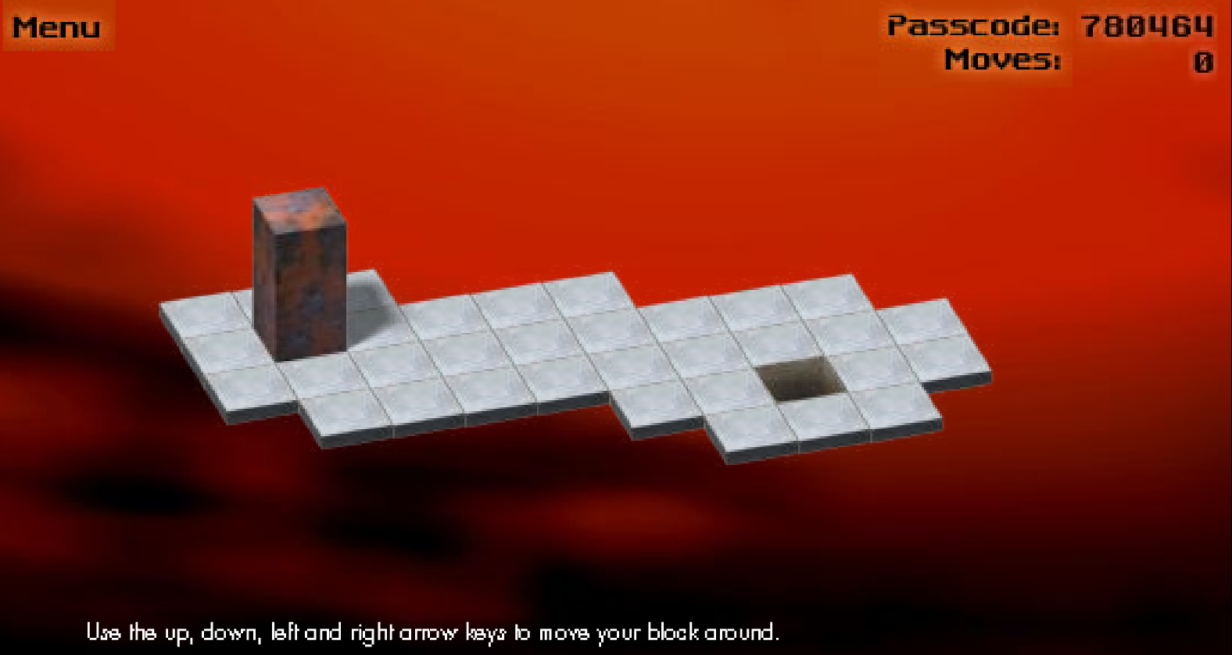
Brief introduction
https://www.mathplayground.com/logic_bloxorz.html
An online puzzle game where players move a 1 by 1 by 2 block by tilting it on a subset of the two dimensional grid. The block was moved from initial position to upright position on the destination square

Slide 4
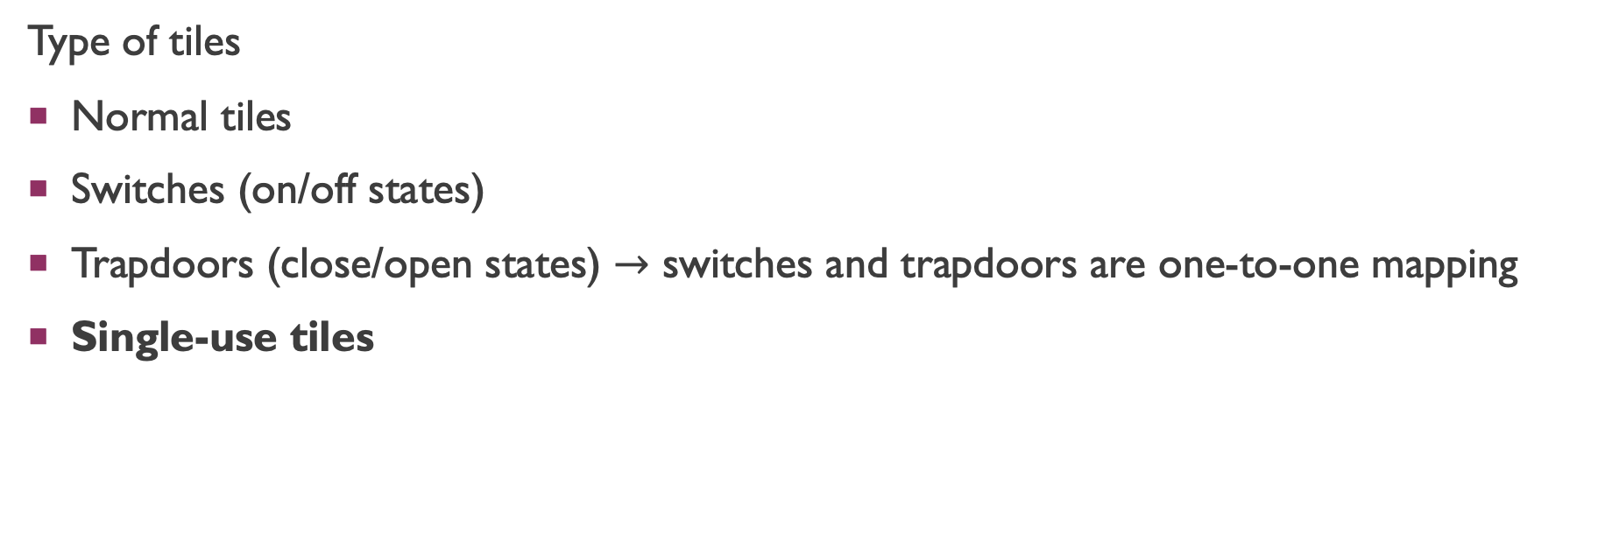
Brief introduction
Type of tiles
Normal tiles
Switches (on/off states)
Trapdoors (close/open states) $→$ switches and trapdoors are one-to-one mapping
Single-use tiles

Slide 5
Complexity of bloxorz
Van Der Zanden, Tom C., and Hans L. Bodlaender. "PSPACE-completeness of Bloxorz and of games with 2-buttons." arXiv preprint arXiv:1411.5951 (2014).
Dec. : decision problem
Opt. : optimization problem, whether it takes less than k steps
Here we focus on single-use tiles problem, it can be reduced from 3-CNF (NPC)

Slide 6
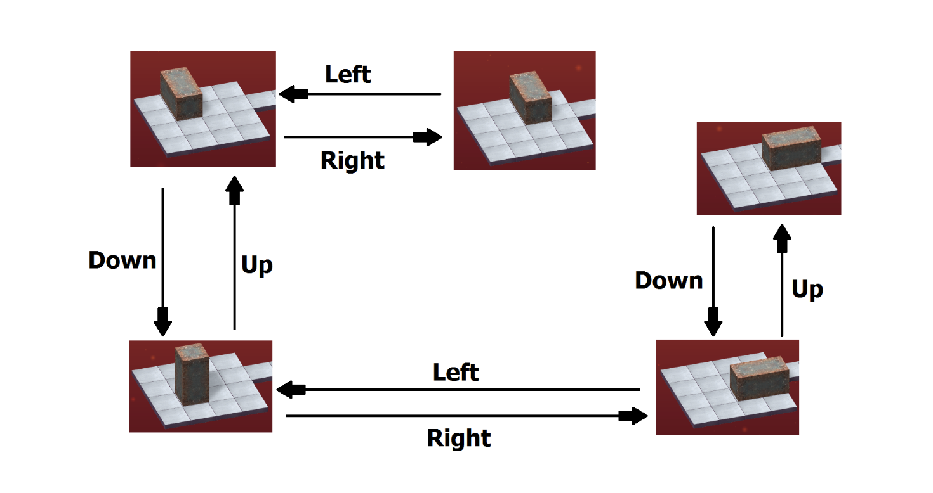
Problem formulation
Instance
Given a level of Bloxorz graph made up by a list of single-use tiles, and a 1 by 1 by 2 block
Question
Is there a sequence of legal move (right, left, down, up) to move from start point to up-right position on goal square

Slide 7
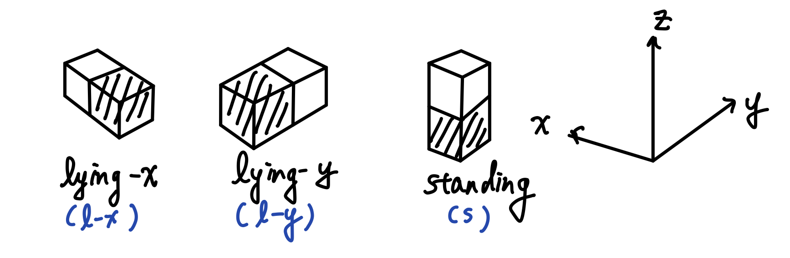

Bloxorz graph
Given a level of Bloxorz, suppose it has total $𝕋$ tiles. For each tile the block can have three unique states on it (choose the closer-to-origin unit). There are total $3∙|𝕋|$ vertices.

Slide 8
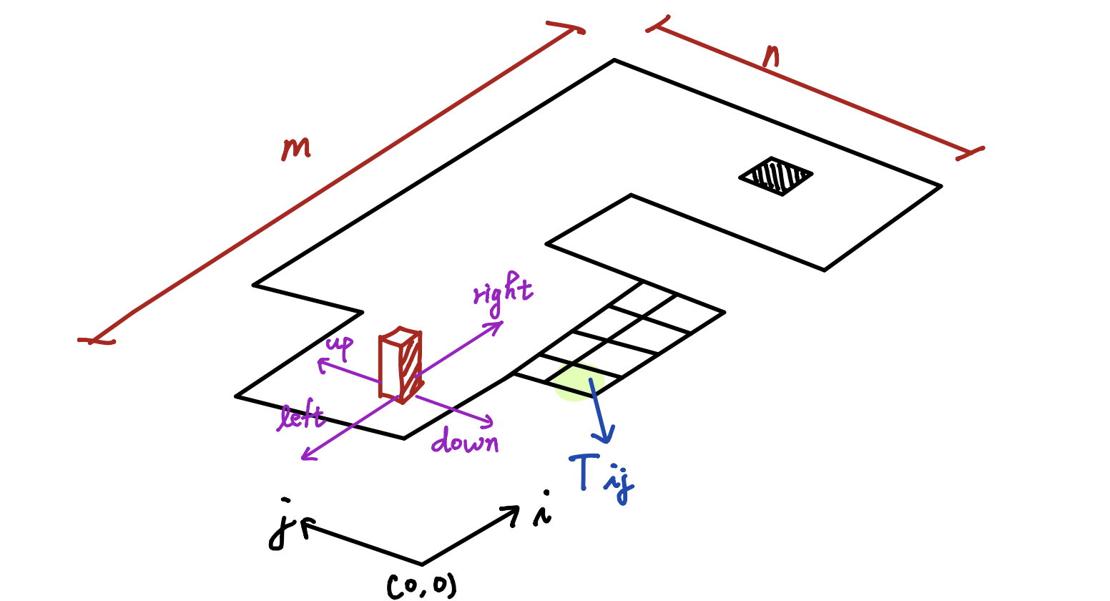
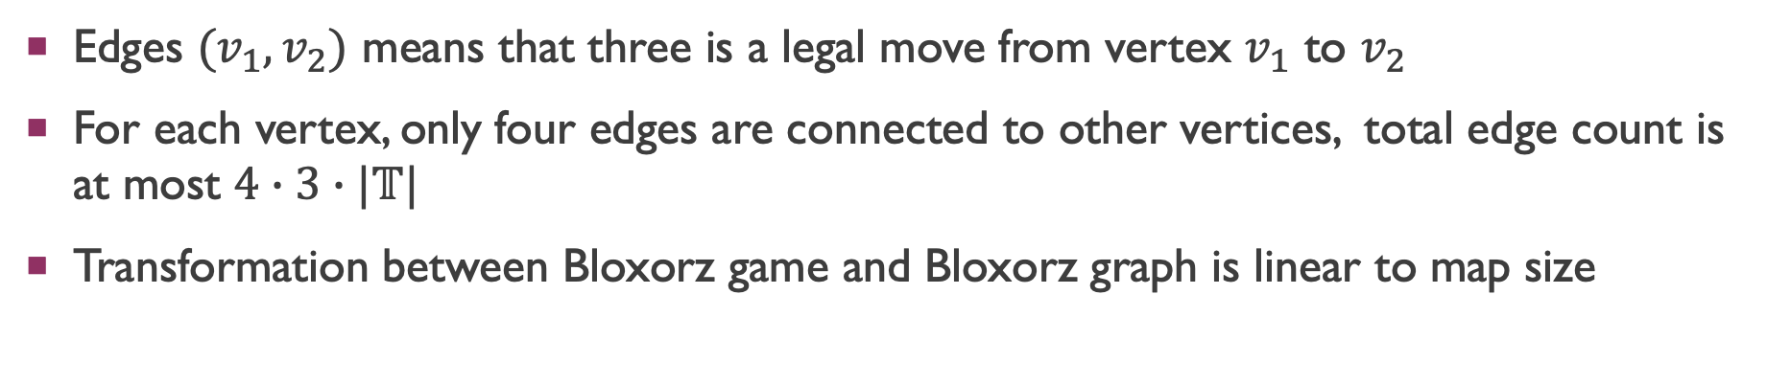
Bloxorz graph
Edges $(v_{1},v_{2})$ means that three is a legal move from vertex $v_{1}$ to $v_{2}$
For each vertex, only four edges are connected to other vertices, total edge count is at most $4∙3∙|𝕋|$
Transformation between Bloxorz game and Bloxorz graph is linear to map size

Slide 9
CNF encoding

Slide 10
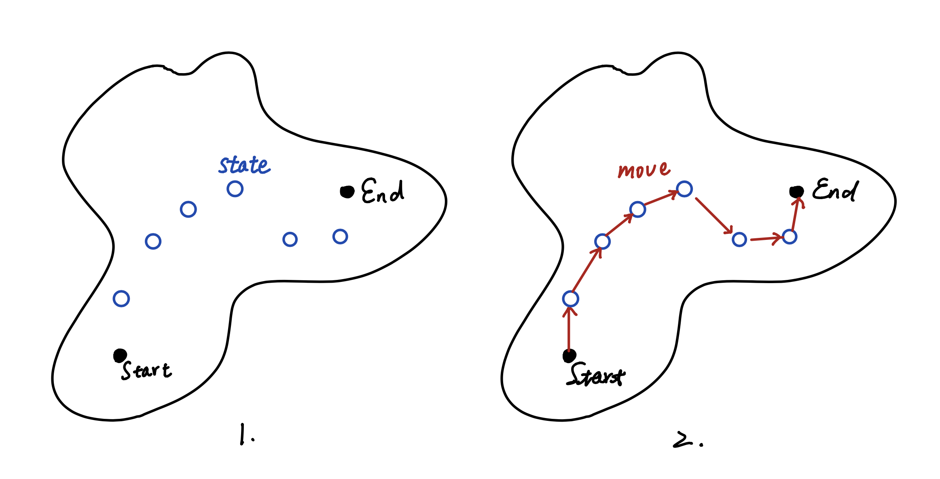
Overall idea
Select a bunch of nodes on Bloxorz graph (these node incorporate location and state info of the block)
Check whether there exist a set of moves (edge) assigned on each selected nodes, to achieve path connection from start to end

Slide 11
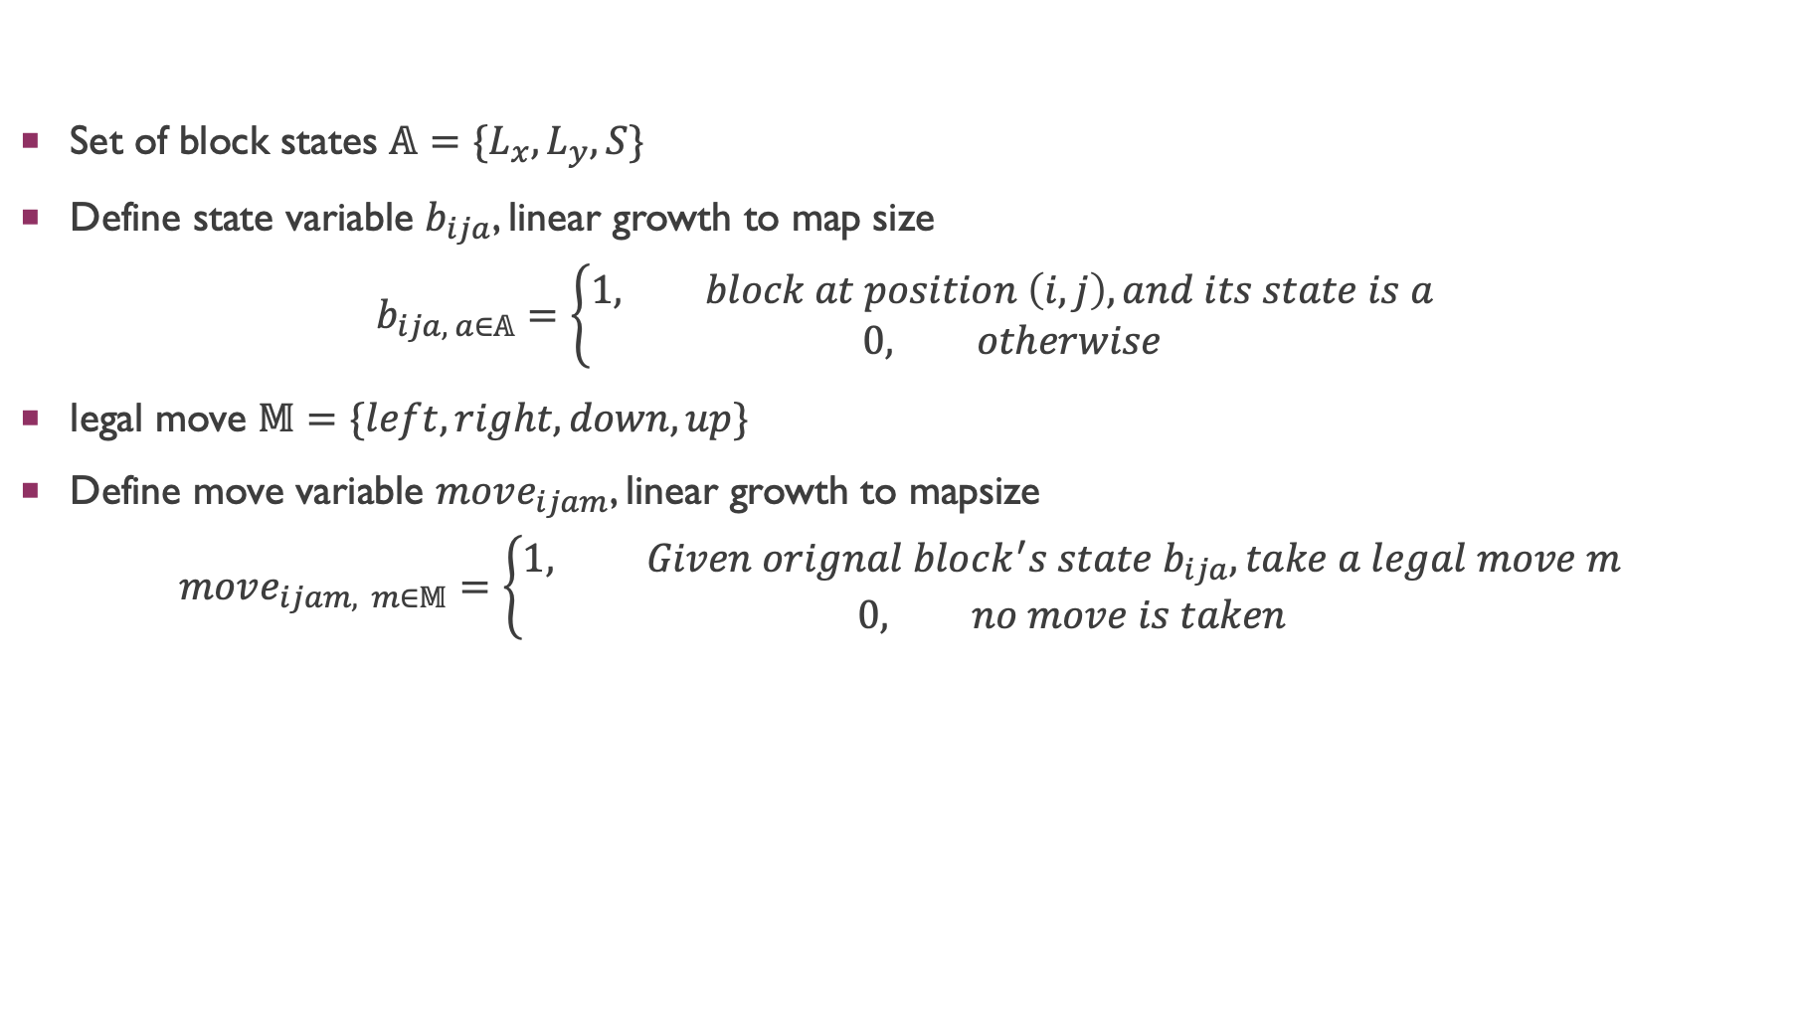
definition
Set of block states $𝔸=\{L_{x}, L_{y}, S\}$
Define state variable $b_{ija}$, linear growth to map size
$$b_{ija, a∈𝔸}=\left\{\begin{aligned}1, block at position \left(i, j\right), and its state is a \\ 0, otherwise\end{aligned}\right.$$
legal move $𝕄=\{left, right, down, up\}$
Define move variable $move_{ijam}$, linear growth to mapsize
$$move_{ijam, m∈𝕄}=\left\{\begin{aligned}1, Given orignal block^{′}s state b_{ija}, take a legal move m \\ 0, no move is taken\end{aligned}\right.$$

Slide 12
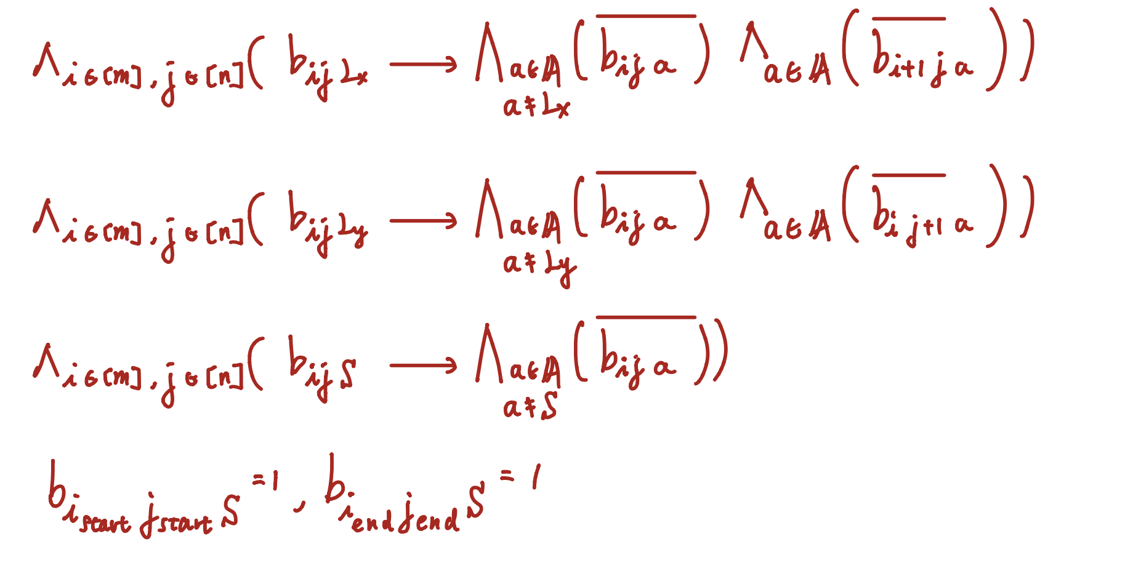

Rules - Select a bunch of states $b_{ija}$
Since a tile can not be passed twice, a whenever a state is taken, some of states are no longer available
Block is originally stand at start point, and it must end standing at goal hole, these two states must be 1
Total clause number: O(map size)

Slide 13
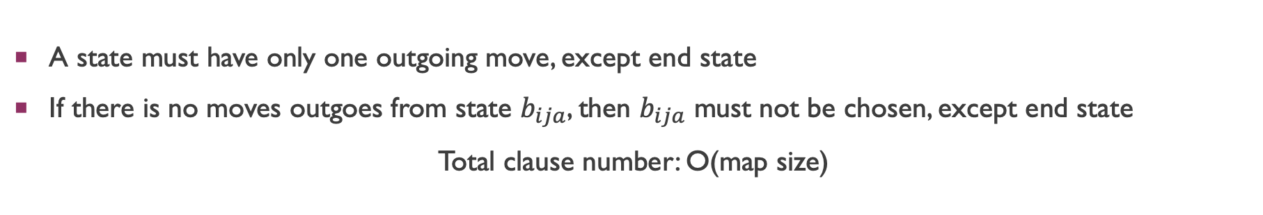
Rules – Choose a set moves
A state must have only one outgoing move, except end state
If there is no moves outgoes from state $b_{ija}$, then $b_{ija}$ must not be chosen, except end state
Total clause number: O(map size)

Slide 14
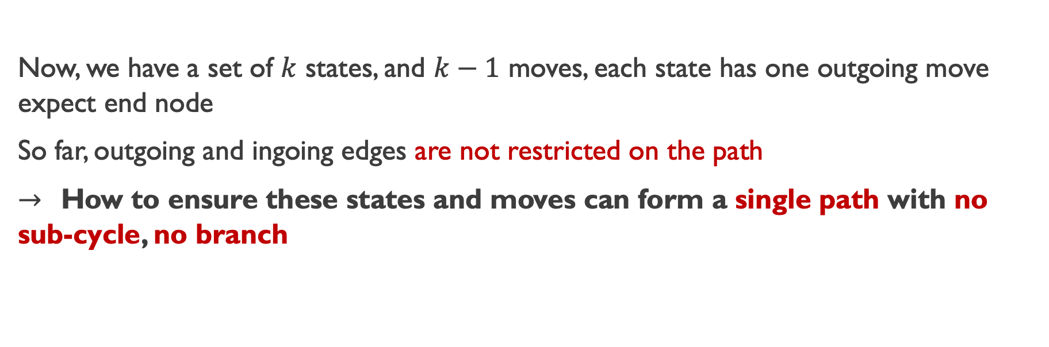
Rules – Successor function
Now, we have a set of $k$ states, and $k−1$ moves, each state has one outgoing move expect end node
So far, outgoing and ingoing edges are not restricted on the path
$→$ How to ensure these states and moves can form a single path with no sub-cycle, no branch
Reference : SAT Encoding for the Hamiltonian Cycle Problem

Slide 15
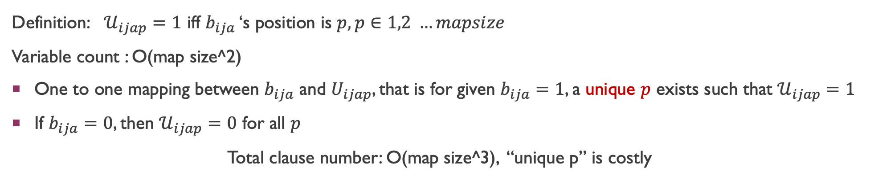
Rules – Successor function
Definition: $𝒰_{ijap}=1$ iff $b_{ija}$ ‘s position is $p, p∈1,2 …mapsize$
Variable count : O(map size^2)
One to one mapping between $b_{ija}$ and $U_{ijap}$, that is for given $b_{ija}=1$, a unique $p$ exists such that $𝒰_{ijap}=1$
If $b_{ija}=0$, then $𝒰_{ijap}=0$ for all $p$
Total clause number: O(map size^3), “unique p” is costly

Slide 16
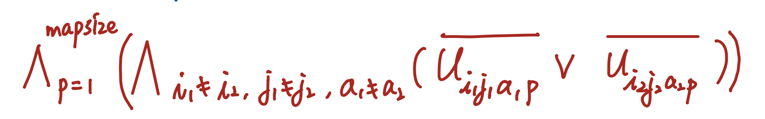
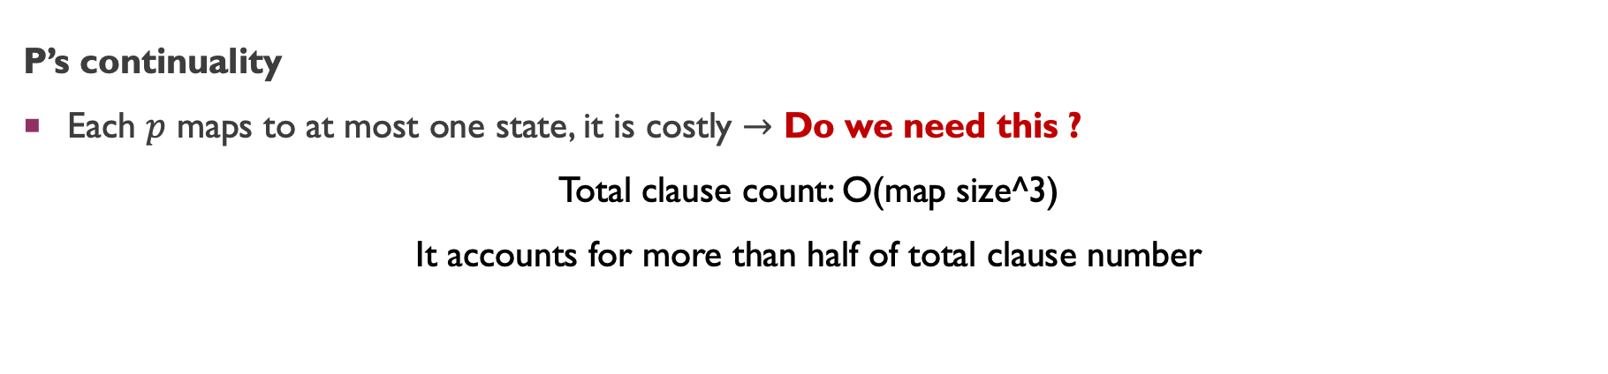
Rules – Successor function
P’s continuality
Each $p$ maps to at most one state, it is costly $→$ Do we need this ?
Total clause count: O(map size^3)
It accounts for more than half of total clause number

Slide 17
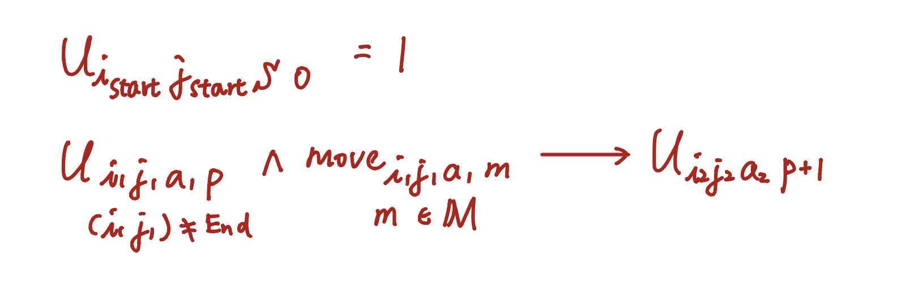
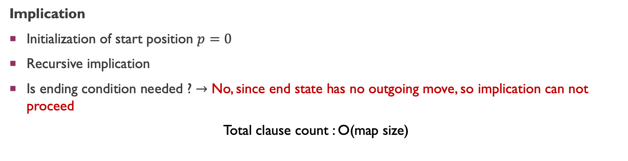
RULES – successor function
Implication
Initialization of start position $p=0$
Recursive implication
Is ending condition needed ? $→$ No, since end state has no outgoing move, so implication can not proceed
Total clause count : O(map size)

Slide 18
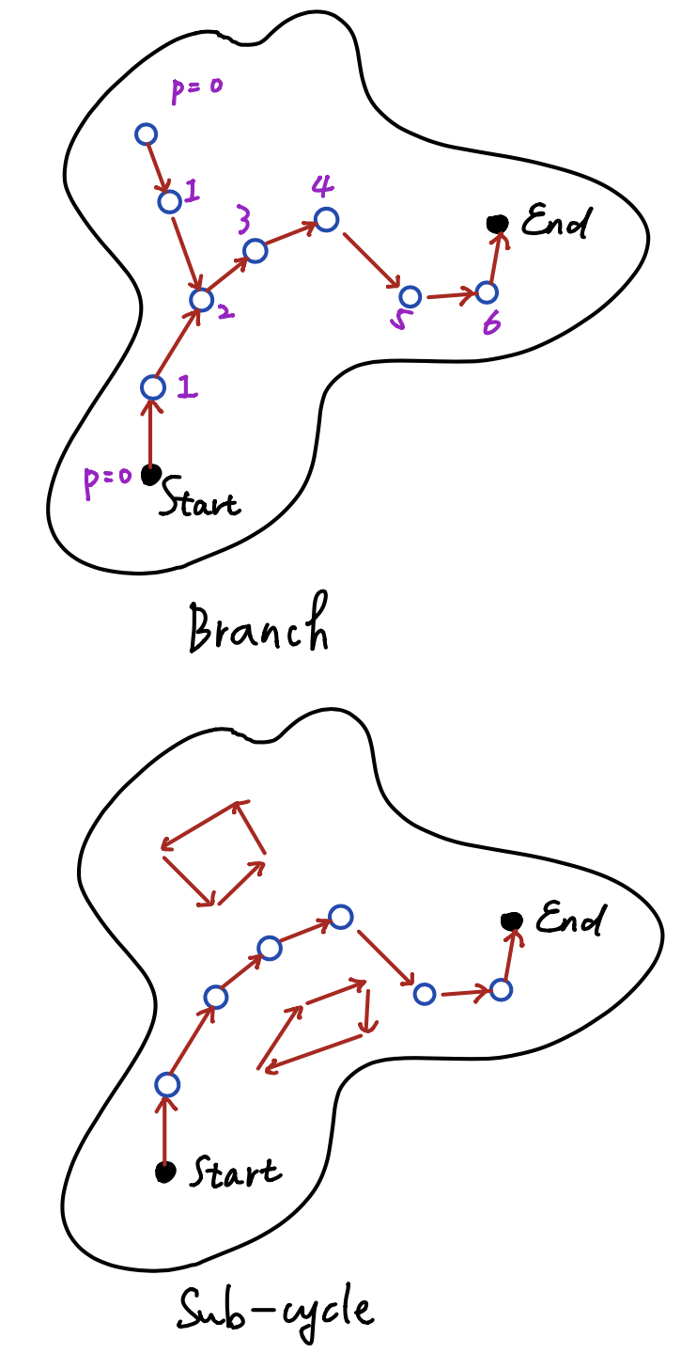
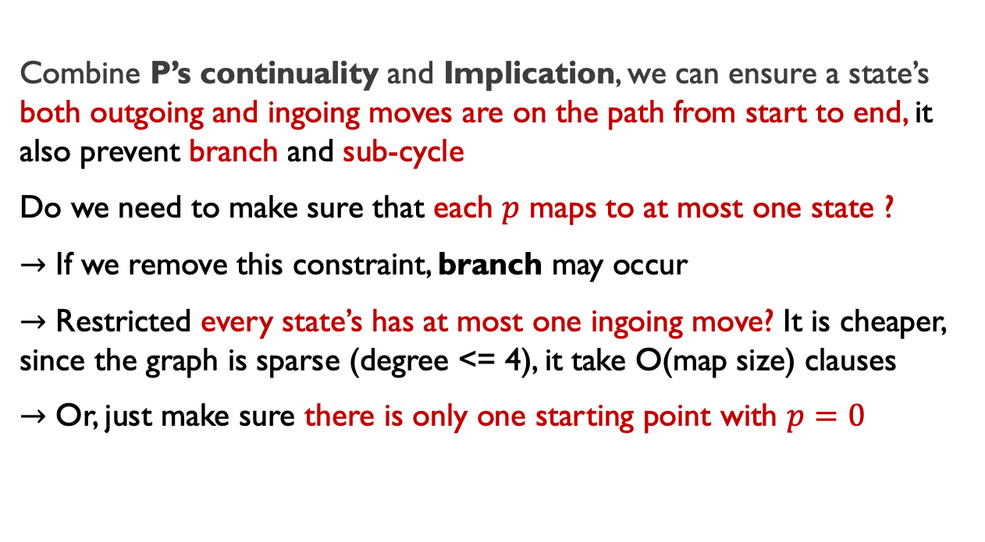
RULES – successor function
Combine P’s continuality and Implication, we can ensure a state’s both outgoing and ingoing moves are on the path from start to end, it also prevent branch and sub-cycle
Do we need to make sure that each $p$ maps to at most one state ?
$→$ If we remove this constraint, branch may occur
$→$ Restricted every state’s has at most one ingoing move? It is cheaper, since the graph is sparse (degree <= 4), it take O(map size) clauses
$→$ Or, just make sure there is only one starting point with $p=0$

Slide 19
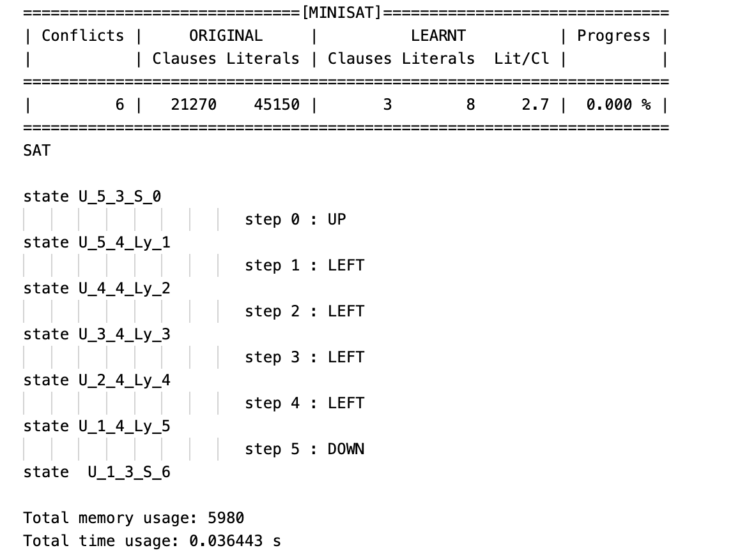
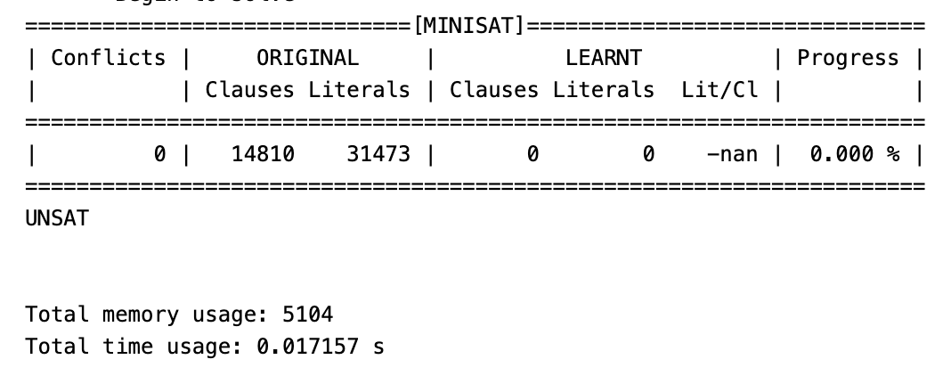
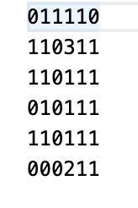
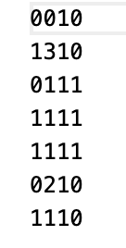
Experiment
Map1
Map2
Map1
LEFT
j
DOWN
UP
i
RIGHT

Slide 20
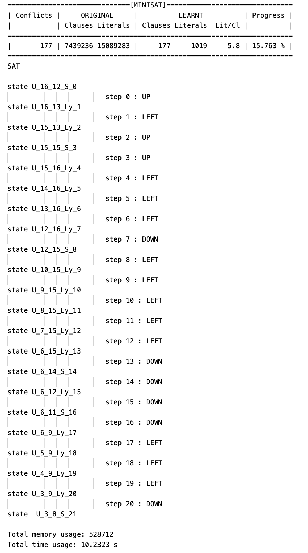
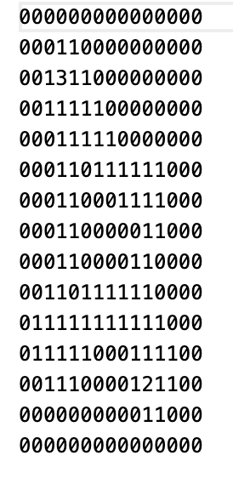
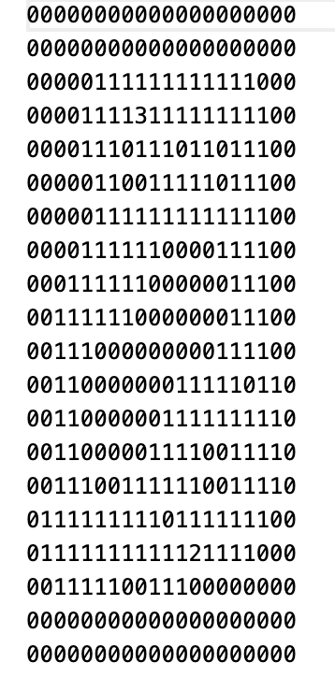
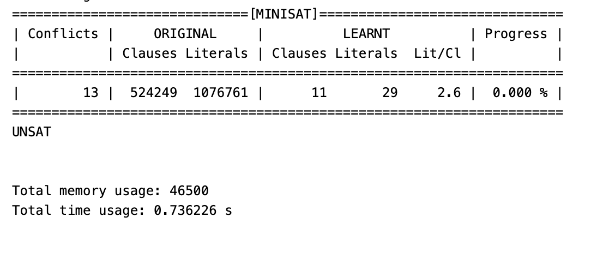
experiment
Map3
Map4
LEFT
j
DOWN
UP
i
RIGHT

Slide 21
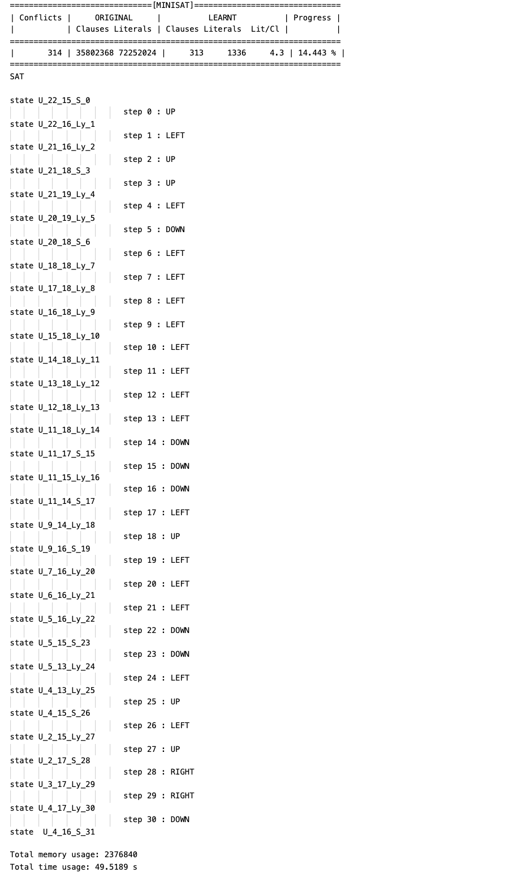
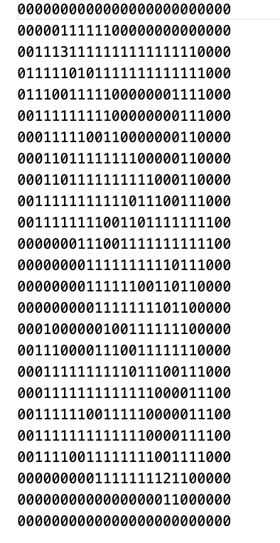
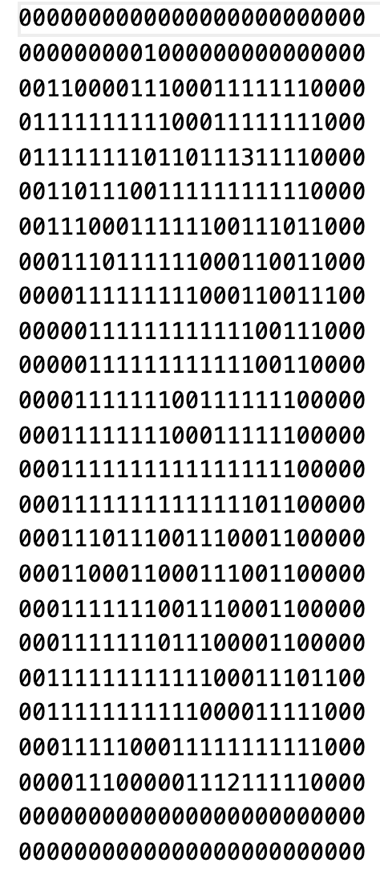
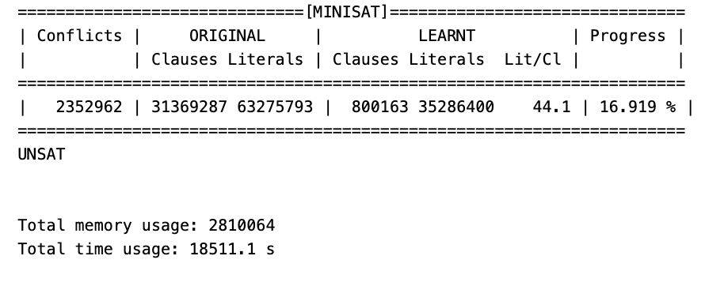
experiment
M5
M6

